Slide 1

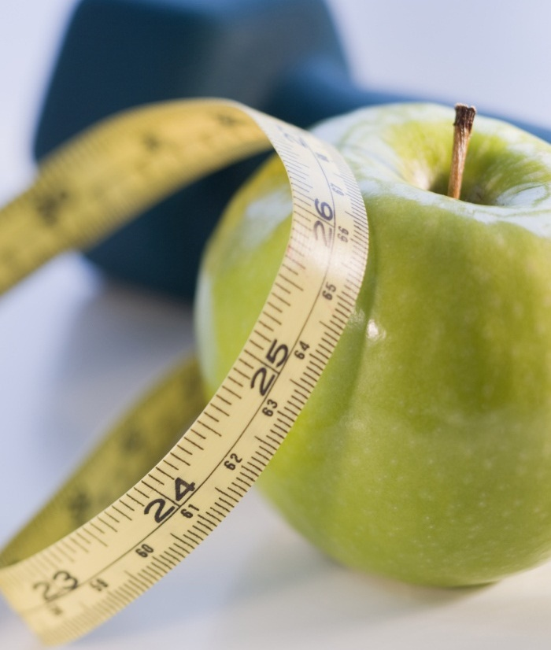

Tennis Match Results Prediction
Josh Zhu
2021

Slide 2
THE PROBLEM STATEMENT
• Determine what statistics are most important in determining the winner of a tennis match
• Build a machine learning model capable of predicting tennis match outcomes (win/loss)
• This is a classification problem
• Possible clients:
• Tennis players and coaches
• Tennis bettors
• Tennis sponsors

Slide 3
THE DATA
• Available on Kaggle
• Downloaded as 21 CSV files from:
https://www.kaggle.com/pablodroca/atp-tennis-matches20002019?select=atp_matches_2000.csv
• Original DataFrame shape: 59,340 rows and 32 columns
• Each row represented a single match, including statistics for both the
winner and the loser

Slide 4
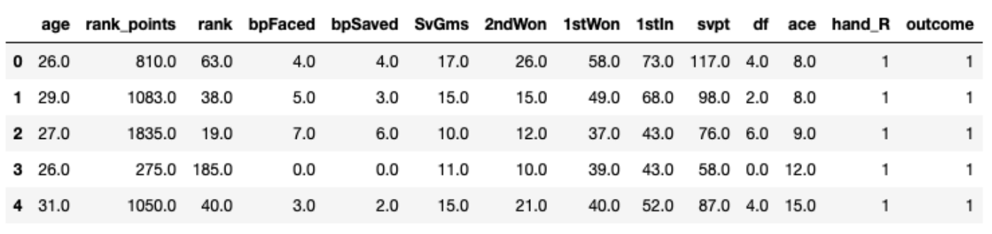
DATA TRANSFORMATION
• Created a new DataFrame where each row represented either a winner or
loser
• Added outcome column where 1 represents a win and 0 represents a loss
• Final DataFrame shape: 86,230 rows and 14 columns (13 features and 1
outcome column)

Slide 5
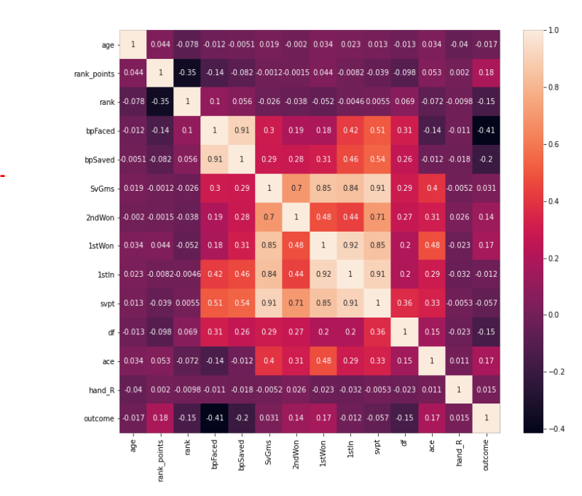
EXPLORATORY DATA ANALYSIS Heatmap showing correlations between features:

Slide 6
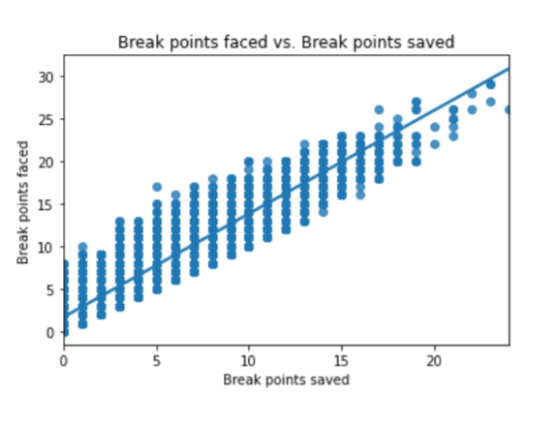
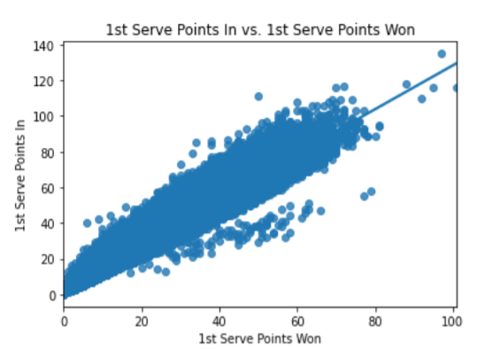
CORRELATIONS BETWEEN FEATURES
• From the heatmap, several features appear to be highly correlated
• Examples:

Slide 7
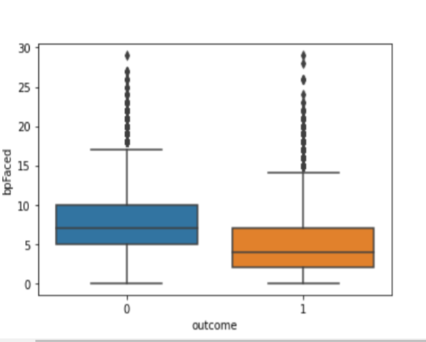
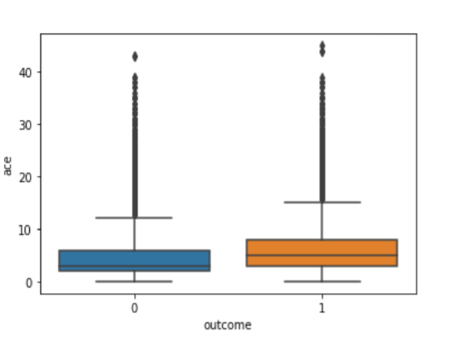
FEATURE EFFECTS ON OUTCOME
• Examples

Slide 8
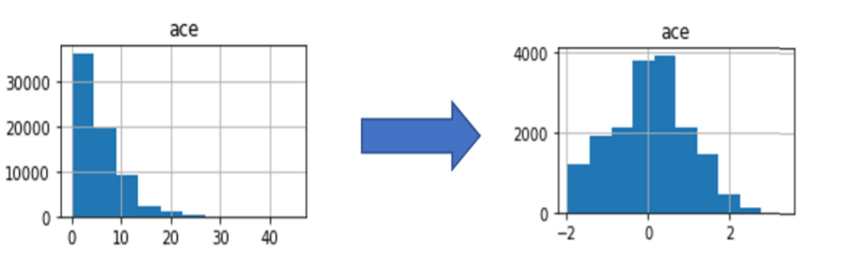
PREPROCESSING
• Standardization and log transformation of features
• Split data into training set (80%) and testing set (20%)
• Final shape of X_train: 68,984 rows by 13 columns

Slide 9
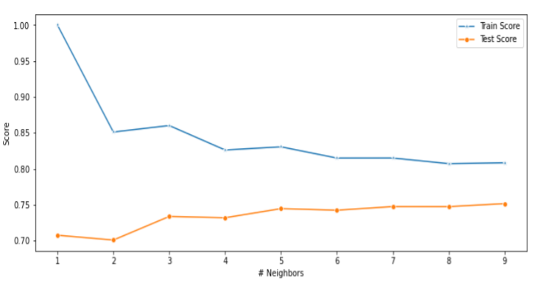
MODELING
Logistic Regression
• Best initial value of regularization parameter, C: 0.01
• K-Nearest Neighbors (KNN)
• Ideal number of neighbors: 3
• Support Vector Machine (SVM)
• Random Forest
• Gradient Boosting
• Naïve Bayes

Slide 10
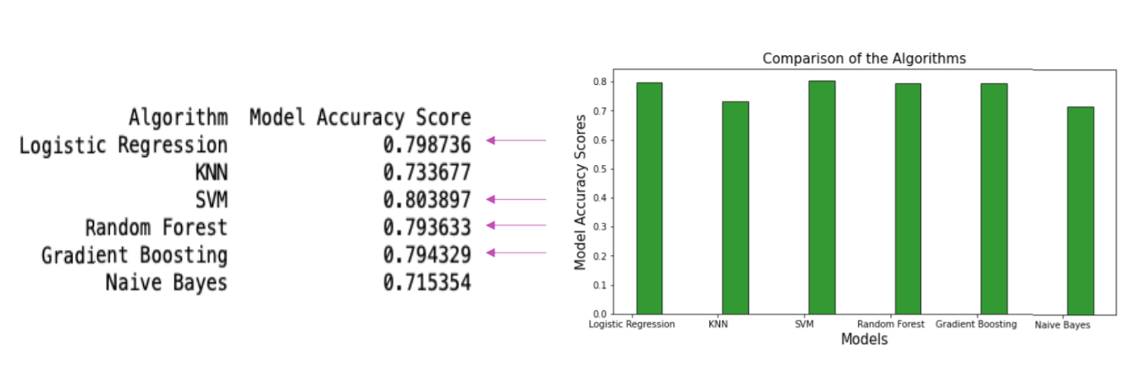
RESULTS: ACCURACY SCORES

Slide 11
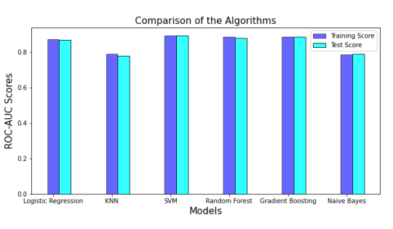
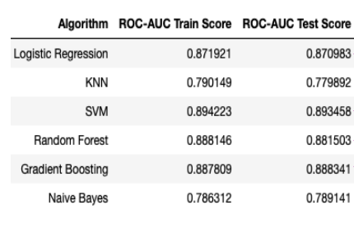
RESULTS: ROC-AUC TRAIN/TEST SCORES

Slide 12
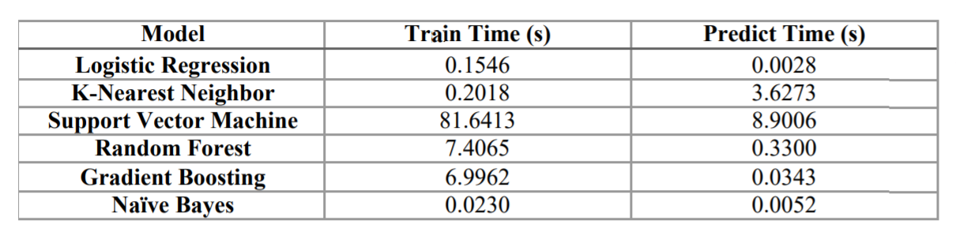
RESULTS: TRAIN AND PREDICT TIMES
• Based on efficiency and model accuracy score, Logistic Regression is the optimal model.

Slide 13
HYPERPARAMETER TUNING
• Performed a Grid Search for Logistic Regression for the regularization parameter (C) and the solver
• Optimal parameters: C=1
• Final model accuracy score: 79.42%

Slide 14
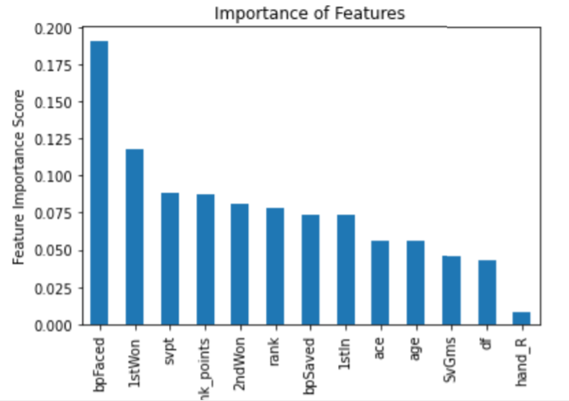
FEATURE IMPORTANCE
• Using Random Forest Model to get feature importance:
• 2 most important features:
• Break points faced
• 1st serve points won

Slide 15
CONCLUSION
The most important statistic in a tennis match is the number of break points won and the number of 1st serve points won
Therefore, according to our model, tennis players should prioritize focusing improving these characteristics of their game to win the most matches

Slide 16
FUTURE DIRECTION
• Here I have used data from the years 2000-2019, but data is available
starting from 1968. The model could possibly be improved if I use data
from earlier years.
• I could investigate model stacking, which utilizes multiple learning
algorithms.
• Finally, I used all 13 features in my models. I could define an importance
cutoff and use features only with an importance higher than the cutoff.
This could improve the model accuracy.

